Slide 1
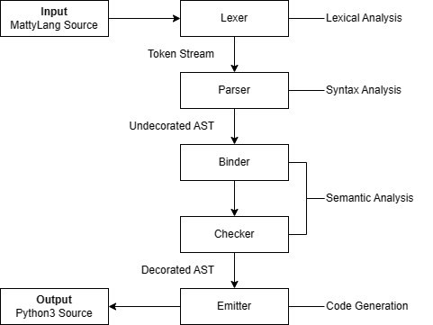
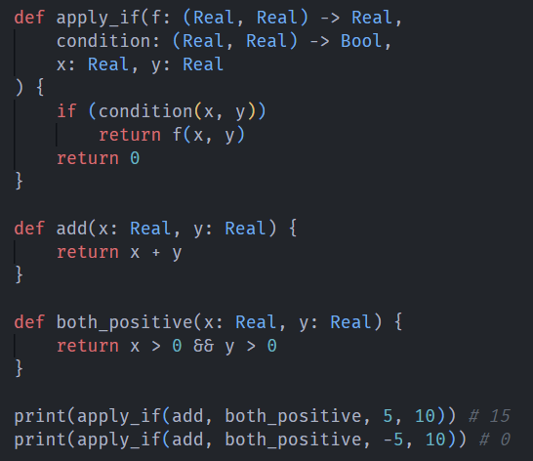
Aiman Darwiche
Grand Canyon University
Compiler Construction and Type Inference
Matthew Ibrahim
Context & Background
Develop a compiler for a custom statically typed language, MattyLang.
Explore the implementation of compilers and type systems.
Compiler Overview
Implications
Can be used as an educational tool or resource.
Can be the foundation of a domain-specific language.
Materials and Methods
Host: Python 3
Testing: Codecov, unittest
Repository: Git/GitHub
Methods: Recursive Descent, Operator Precedence Parsing
MattyLang Example
References
History of C++. cppreference.com. Retrieved August 15, 2022.
Placeholder Type Specifiers. cppreference.com. Retrieved August 15, 2022.
We would like to acknowledge the support and feedback received from our GCU peers, as their feedback and support helped to ensure project success.

